Slide 1
ETL Project – Happiness & Life Expectancy
Group Members
Jasjeet Kaur
Erika Hoshino
Saleha Khatun

Slide 2
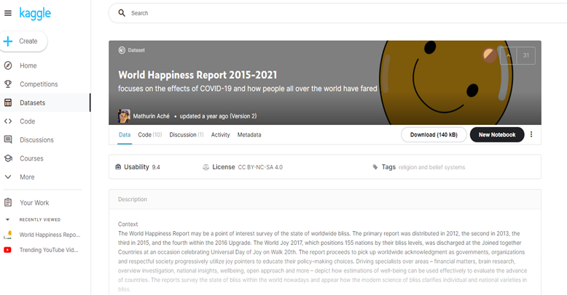
Key Dataset
Our group aimed to explore the happiness rankings of countries across the world, focusing on specific factors such as the freedom to make life choices, social support and GDP per capita. In addition, we analysed the life expectancy rankings of countries worldwide. Further analysis can be performed to determine any correlations between happiness factors and countries with higher life expectancies.
https://www.kaggle.com/mathurinache/world-happiness-report-20152021?select=2015.csv

Slide 3
The sources are listed below:
World Happiness Report 2015-2021 (Kaggle)
https://www.kaggle.com/mathurinache/world-happiness-report-20152021?select=2019.csv
Human Life Expectancy Around the World (Kaggle)
https://www.kaggle.com/deepcontractor/human-life-expectancy-around-the-world
Extraction
● We utilised 2 datasets from the public platform Kaggle; the ‘World Happiness Report’ and the ‘Human Life Expectancy Around the World’ report. The World Happiness Report dataset listed information for 158 countries between the years of 2015 to 2021, and the Human Life Expectancy dataset comprised of a collection of 186 countries ranging from 1990 to 2019.
● We focused on extracting the data from 2019 from both datasets for consistency.

Slide 4
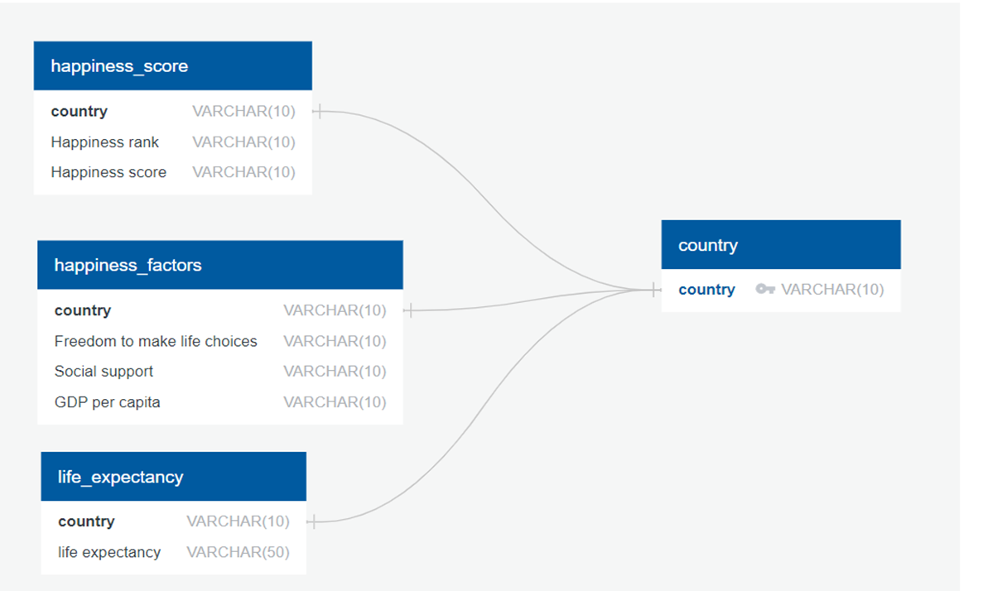
ERD

Slide 5
Extraction
●The factors of interest from the World Happiness Report are as follows:
-Freedom to make life choices
-Social support
-GDP per capita
-Happiness rank
-Happiness score
●The factors of interest from the World Happiness Report are as follows:
-Freedom to make life choices
-Social support
-GDP per capita
-Happiness rank
-Happiness score
●The factors of interest from the World Happiness Report are as follows:
-Freedom to make life choices
-Social support
-GDP per capita
-Happiness rank
-Happiness score

Slide 6
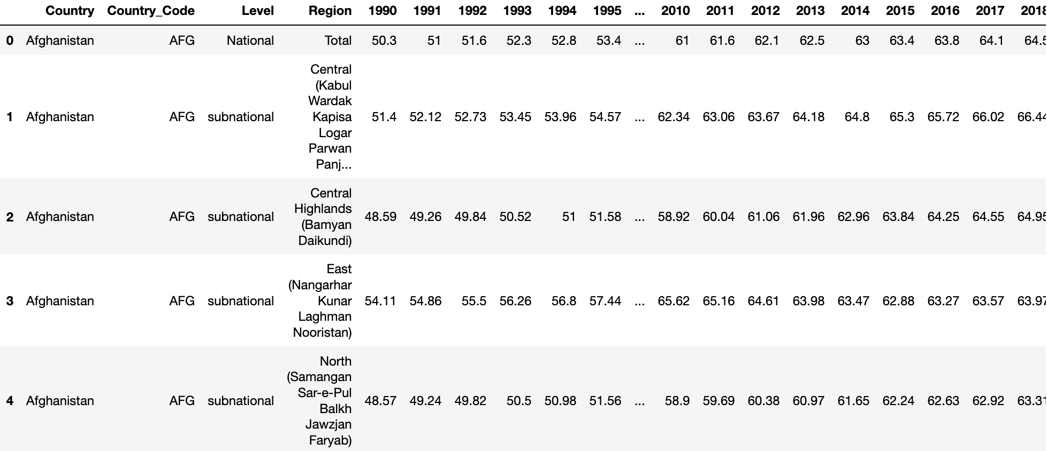
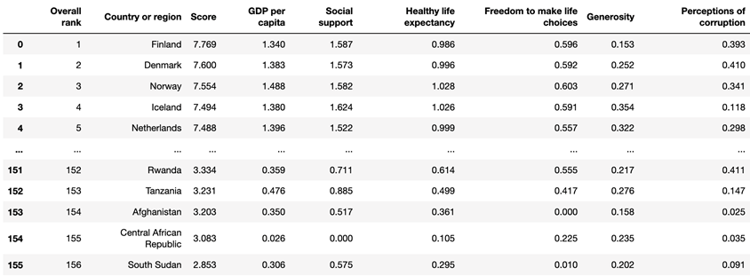
Extraction
Read the CSV of the World Happiness & Life Expectancy datasets into a pandas dataframe using Jupyter notebook.

Slide 7
Extraction
Tools Used
Pandas
PostgreSQL
SQL Alchemy

Slide 8
Transform
• Dropped unwanted columns, filtered for selected factors:
Happiness Rank
Happiness Score
Freedom to make life choices
Social support
GDP per capita
Year
• Renamed columns
• Merged data frames based on country

Slide 9
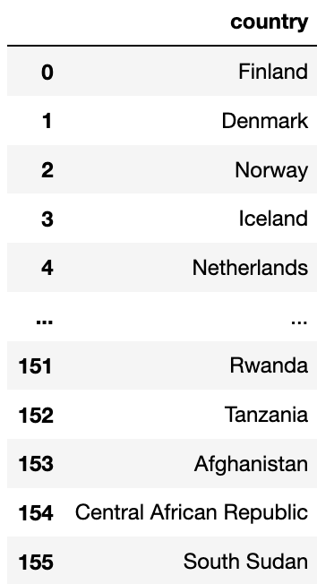
Transform
’Country or region’
Primary Country Data frame
Selected for ‘Country or Region’ column
Renamed column for better comprehension & consistency
Notes:
https://www.carsguide.com.au/car-news/women-are-better-drivers-than-men-report-31199

Slide 10
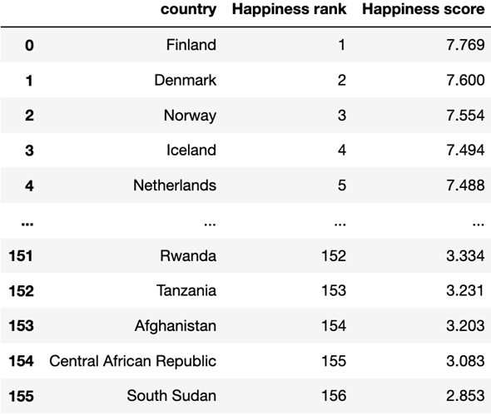
Transform
’Country or region’
‘Overall rank’
‘Score’
Happiness Score Data frame
- Filter by rank and score
- Rename columns for better comprehension
Notes:
https://www.carsguide.com.au/car-news/women-are-better-drivers-than-men-report-31199

Slide 11
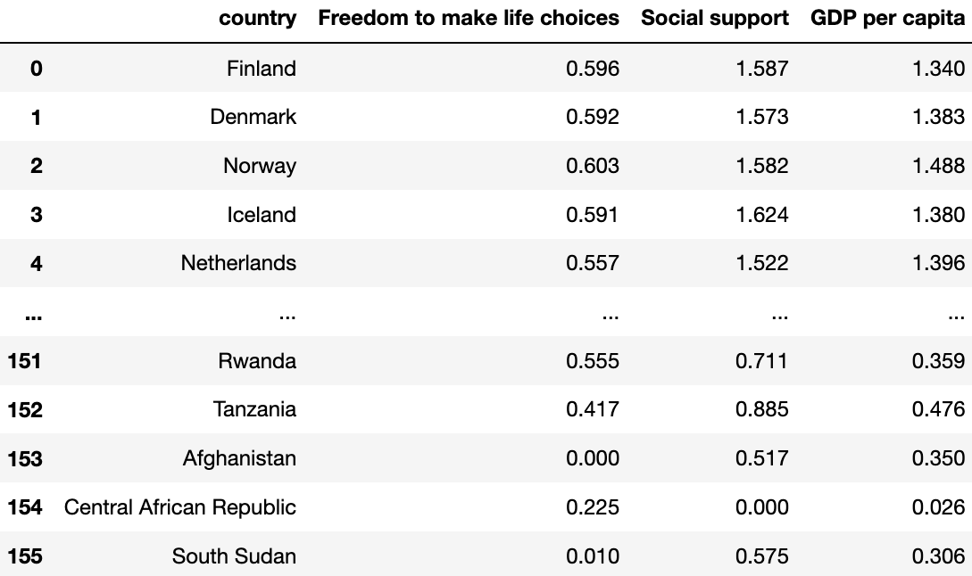
Transform
‘Country or region’
Selected Factors
Happiness Factors Data frame
Filter for selected factors
Notes:
https://www.carsguide.com.au/car-news/women-are-better-drivers-than-men-report-31199

Slide 12
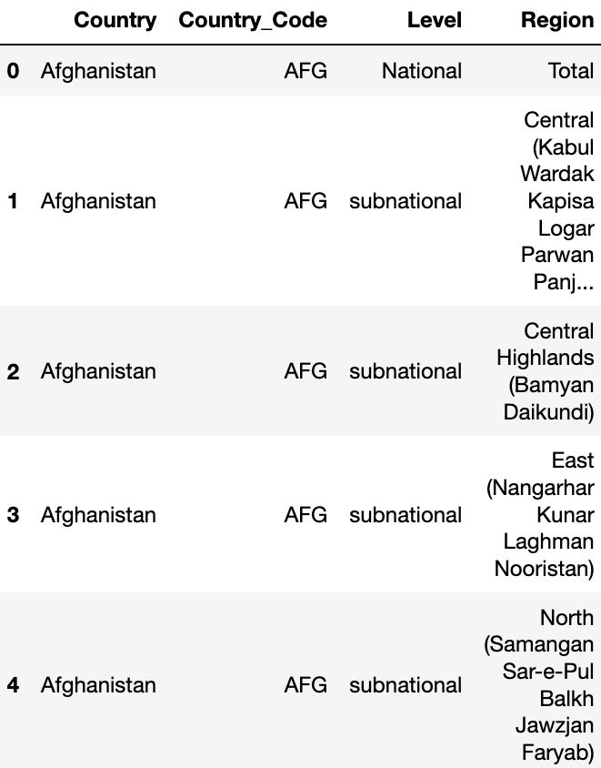
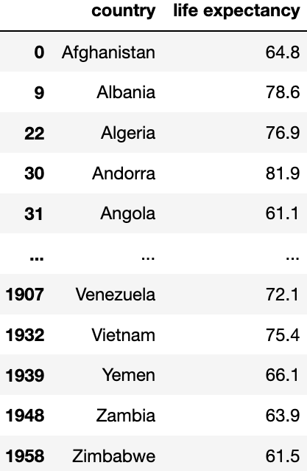
Transform
Life Expectancy Data frame
Filter for specific year (2019) & Country by Region - Total
2019
Notes:
https://www.carsguide.com.au/car-news/women-are-better-drivers-than-men-report-31199

Slide 13
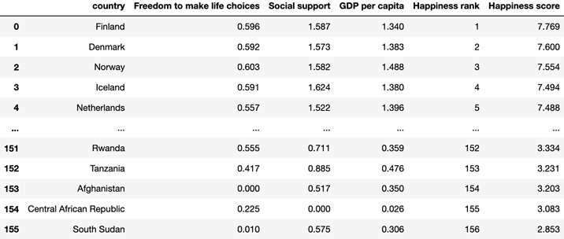
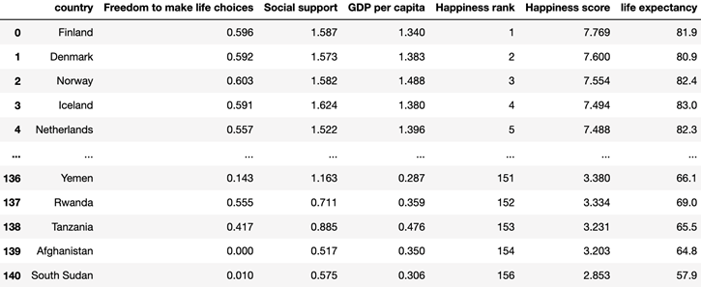
Transform
We also combined the Happiness Factor & Happiness Score data frames and then with the Life Expectancy data frame
Cleaned & merged!

Slide 14
Load
The final process involved loading the combined Happiness & Life Expectancy data frame into a database. This was achieved by creating a connection with the local SQL database and using pandas to load the csv converted data frame to a database.

Slide 17
Thanks You!

